Slide 1
CENTURION UNIVERSITY
TECHNOLOGY AND MANAGEMENT
VLSI DESIGN
4-BIT VEDIC MULTIPLIER
NAME REG. NO.
Mukesh Kumar Pandey 210101120003
ABHISHEK TIWARI 210101120022
SHIVAM KUMAR TIWARI 210101120023
NIRAJ UPADHYAY 210101120025
UJJWAL TIWARI 210101120029
GUIDED BY :- Prof. SN PADHY

Slide 2
Content
Abstract
Introduction
OBJECTIVE
METHODOLOGY and Software Tools Used
Demonstration
Code Implementation
Result
Conclusion
Reference

Slide 3
Abstract
The need of high speed multiplier is increasing as the need of high speed processors are increasing. A Multiplier is one of the key hardware blocks in most of the fast processing systems which is not only a high delay block but also a major source of power dissipation. A conventional processor requires substantially more hardware resources and processing time in the multiplication operation, rather than addition and subtraction. We are describes about the design of 4-bit, multiplier using ancient Vedic mathematics which helps in delay and power reduction. Simulation is done in Xilinx 14.7 software .

Slide 4
Introduction of Vedic multiplier
The word “Vedic” is derived from the word “Veda” which means the store-house of all knowledge. Vedic Mathematics is an ancient system of mathematics existed in India.
Vedic multiplier is proposed using Urdhva Tiryagbhyam Sutra which is simple and increases the speed by computing partial products in parallel
A1 A0
B1 B0
2 bit Vedic multiplier

Slide 5
Objective
There are many ways of 4 bit multiplier but we can reduce the time, power consumption and space by using Vedic formula.

Slide 6
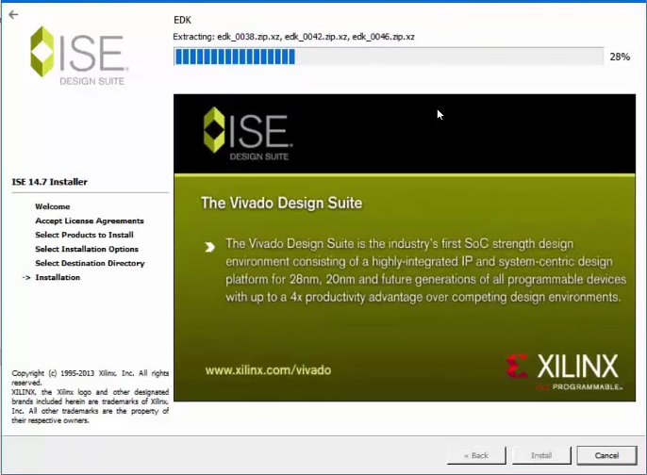

Slide 7
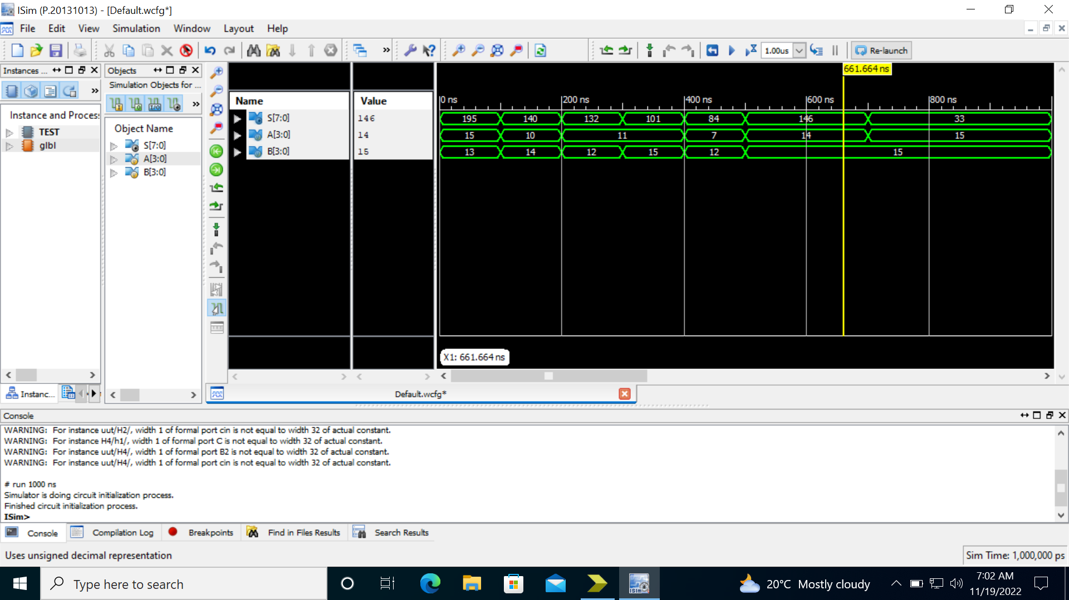

Slide 8
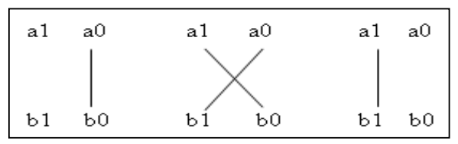
4 bit Vedic multiplier
To do 4 bit Vedic Multiplier we will need 2 Bit Vedic Multiplier first as we will be doing Structure Programming. And before that we have to do 2 bit multiplier
These are the step of Vedic multiplication
Step1 Step2 Step3

Slide 9
Demonstration of 2 bit Vedic multiplier
1 1
1 1
Step 3
(1 x 1 + 1 ) = 10
Step 2
(1 x 1 + 1 x 1) = 10
Step 1
1 x 1 = 1
1 0 0 1

Slide 10
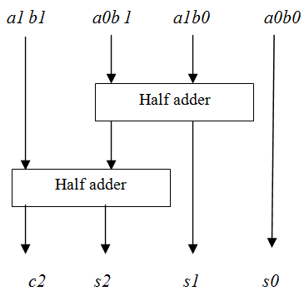
Circuit diagram of 2 bit Vedic multiplier

Slide 11
4 bit Vedic multiplier using 2 bit Vedic multiplier Demonstration
Step : - 1
Divide our bit N/2 Multiplier
Step : - 2
Multiply First two Bit. After multiply first two is my output.
A3 A2
A1 A0
B3 B2
B1 B0

Slide 12
Step : - 3
After step 2 we do Cross multiply and add it. We found sum and carry and keep it.
Step : - 4
Sum of step 3 add with step 1 Last two bit Again we find sum and carry
Step : - 5
Step 4 first two bit our output and last 2 bit is our input to next adder (except carry).
Step : - 6
Add the step 3 carry and step 4.
Step : - 7
Step 6 2 bit and step 5 last two bit together will form a number.
Step : - 8
Multiply last two bit and add with step 7. We find 4 bit sum and 1 bit carry. So sum is my output and carry is always 0.

Slide 13
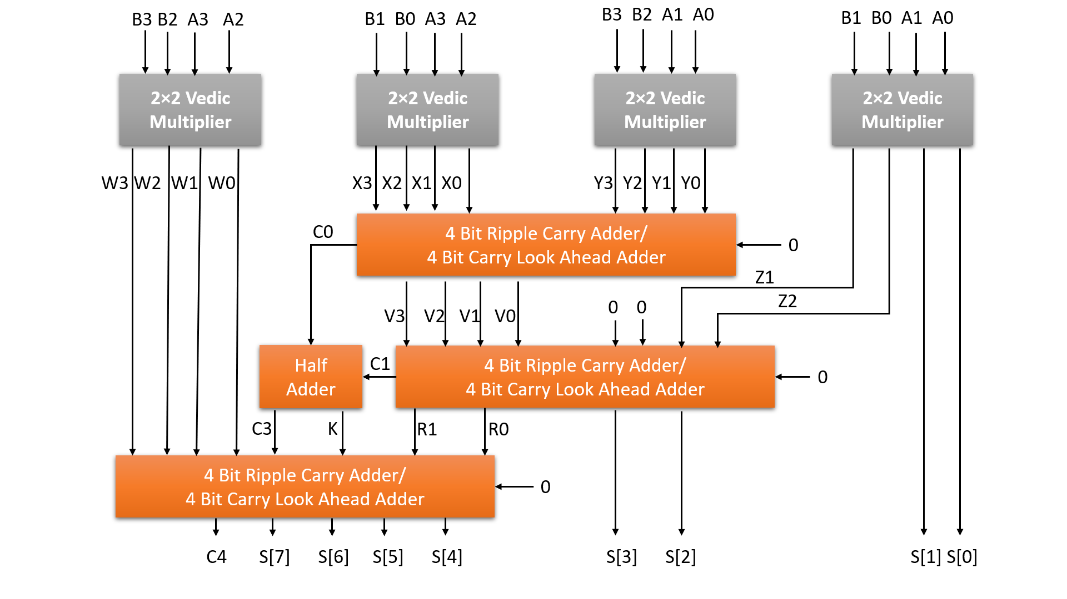

Slide 14


Slide 15
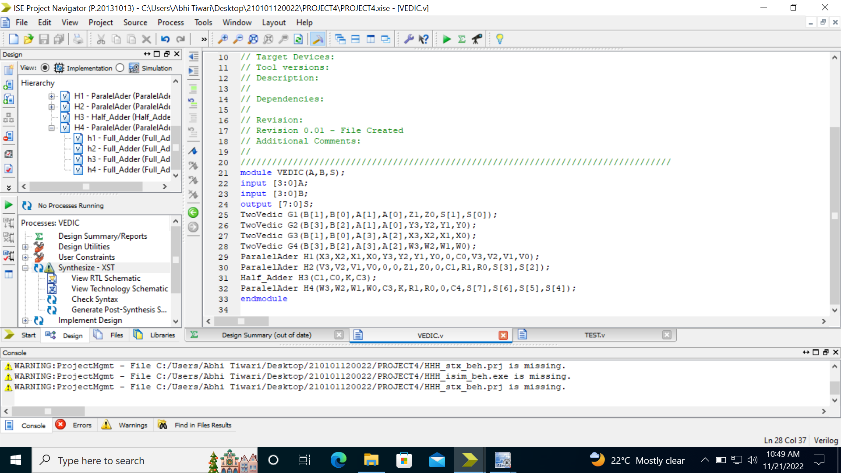

Slide 16
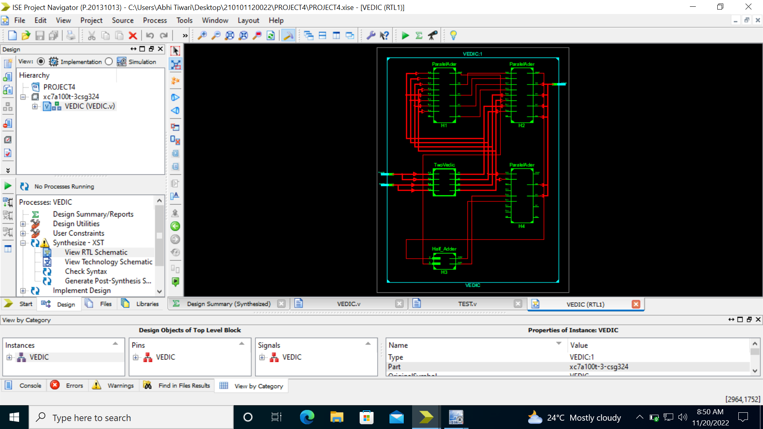
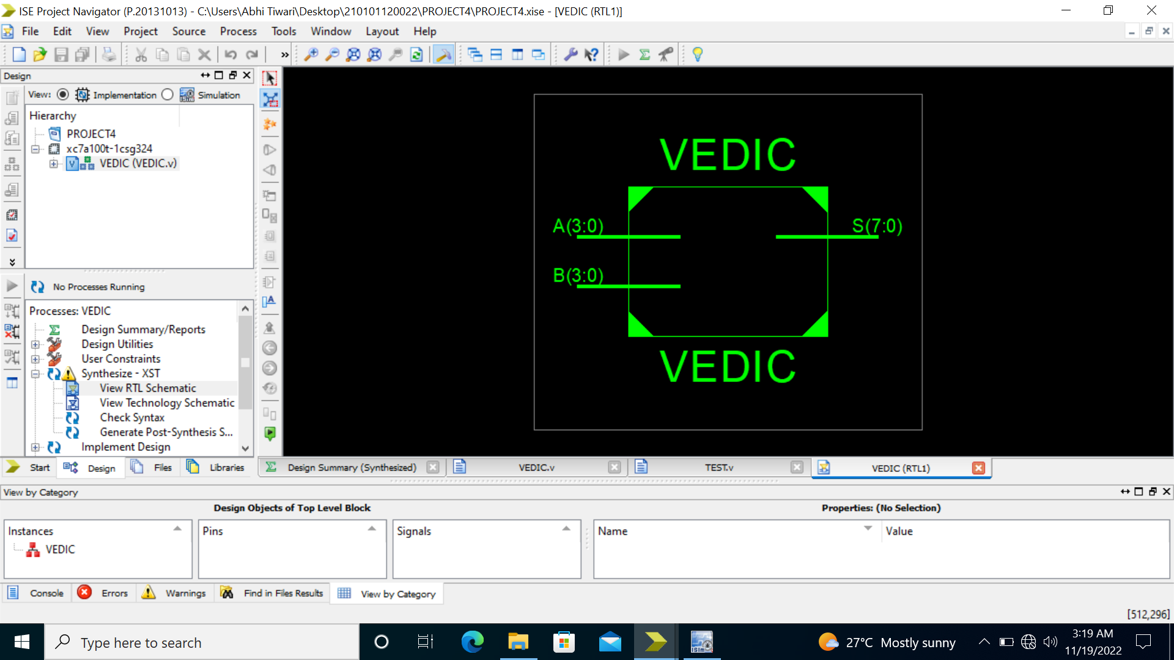

Slide 17
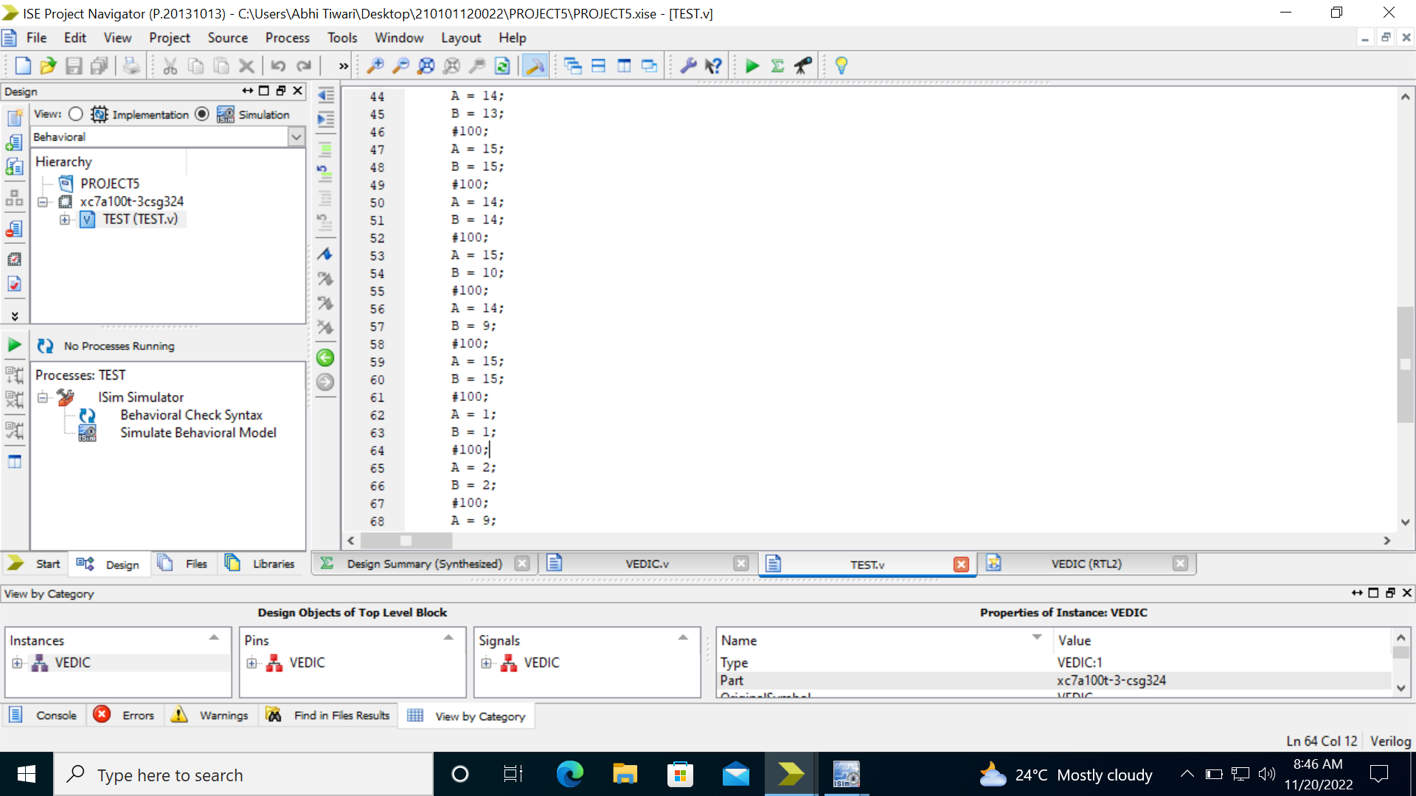

Slide 18

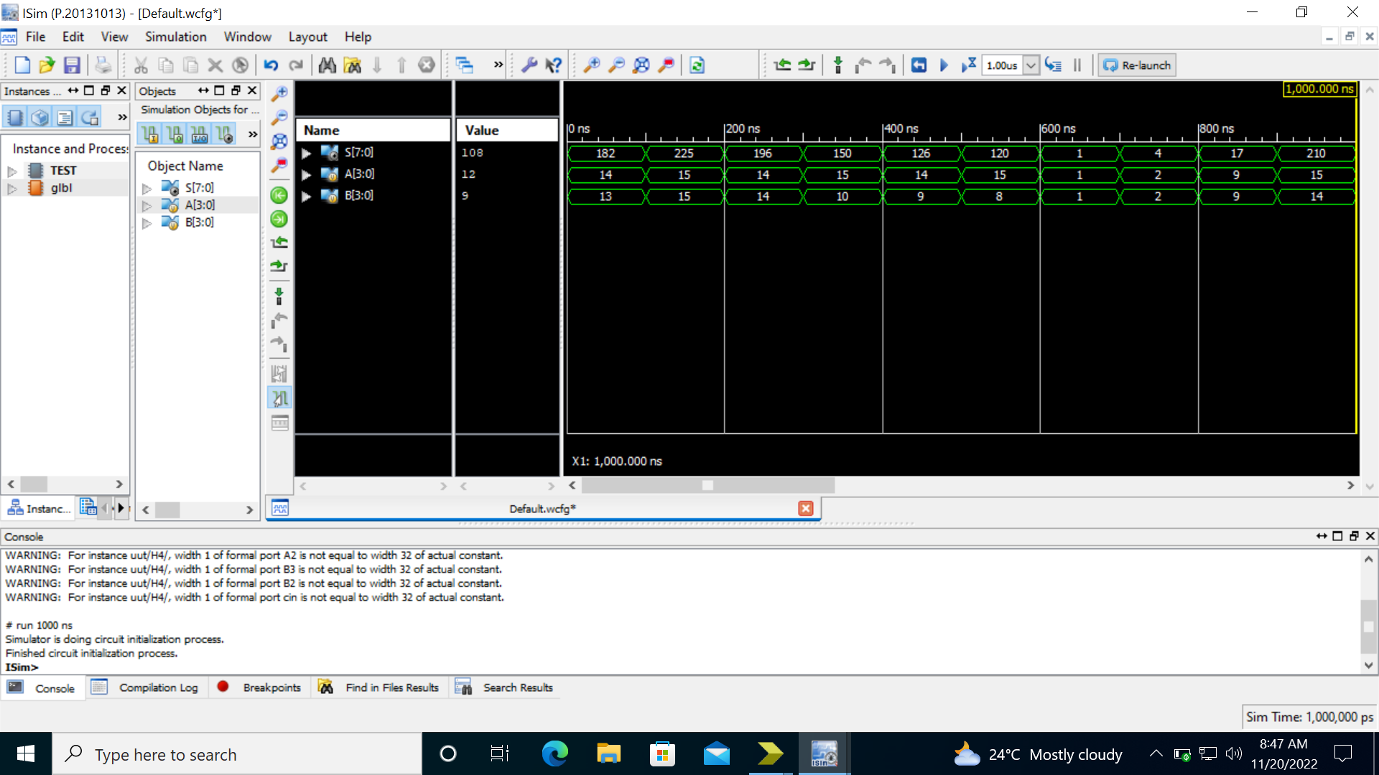
Output in binary form
Output in Decimal form

Slide 19
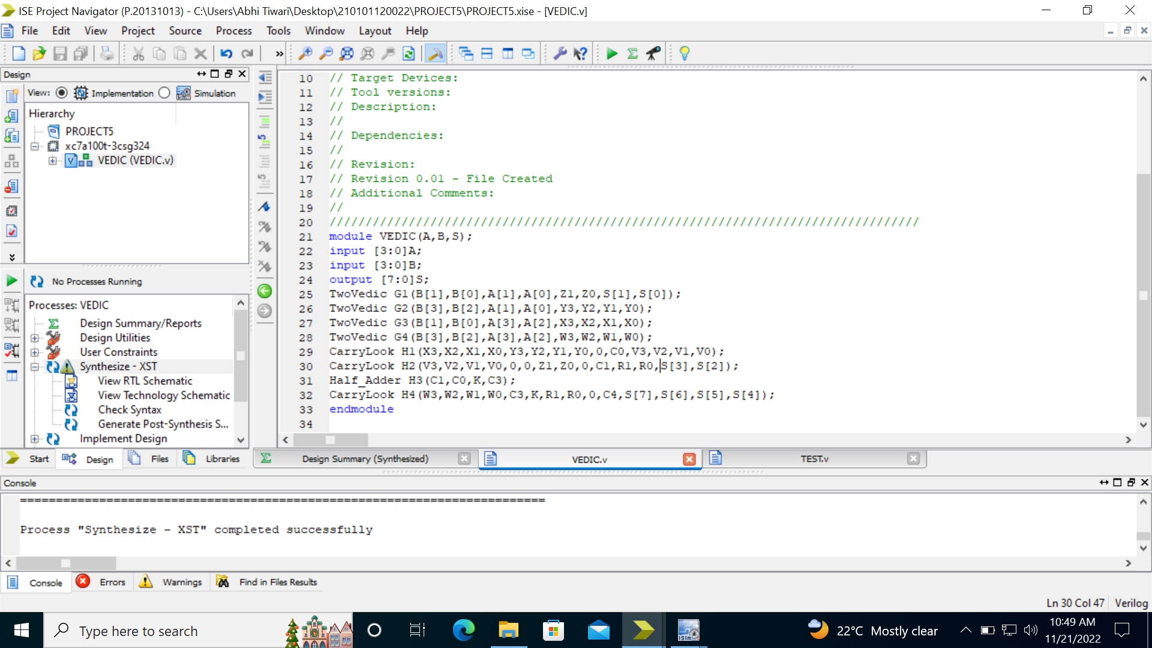

Slide 20
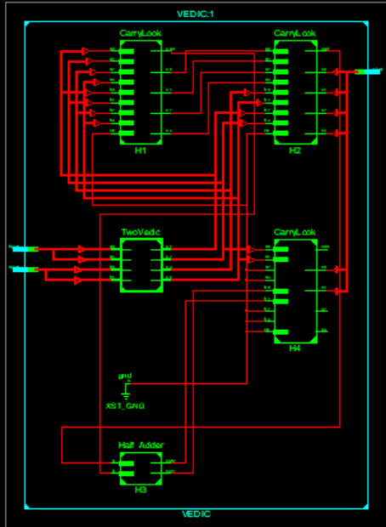

Slide 22
Output in binary form
Output in Decimal form

Slide 23
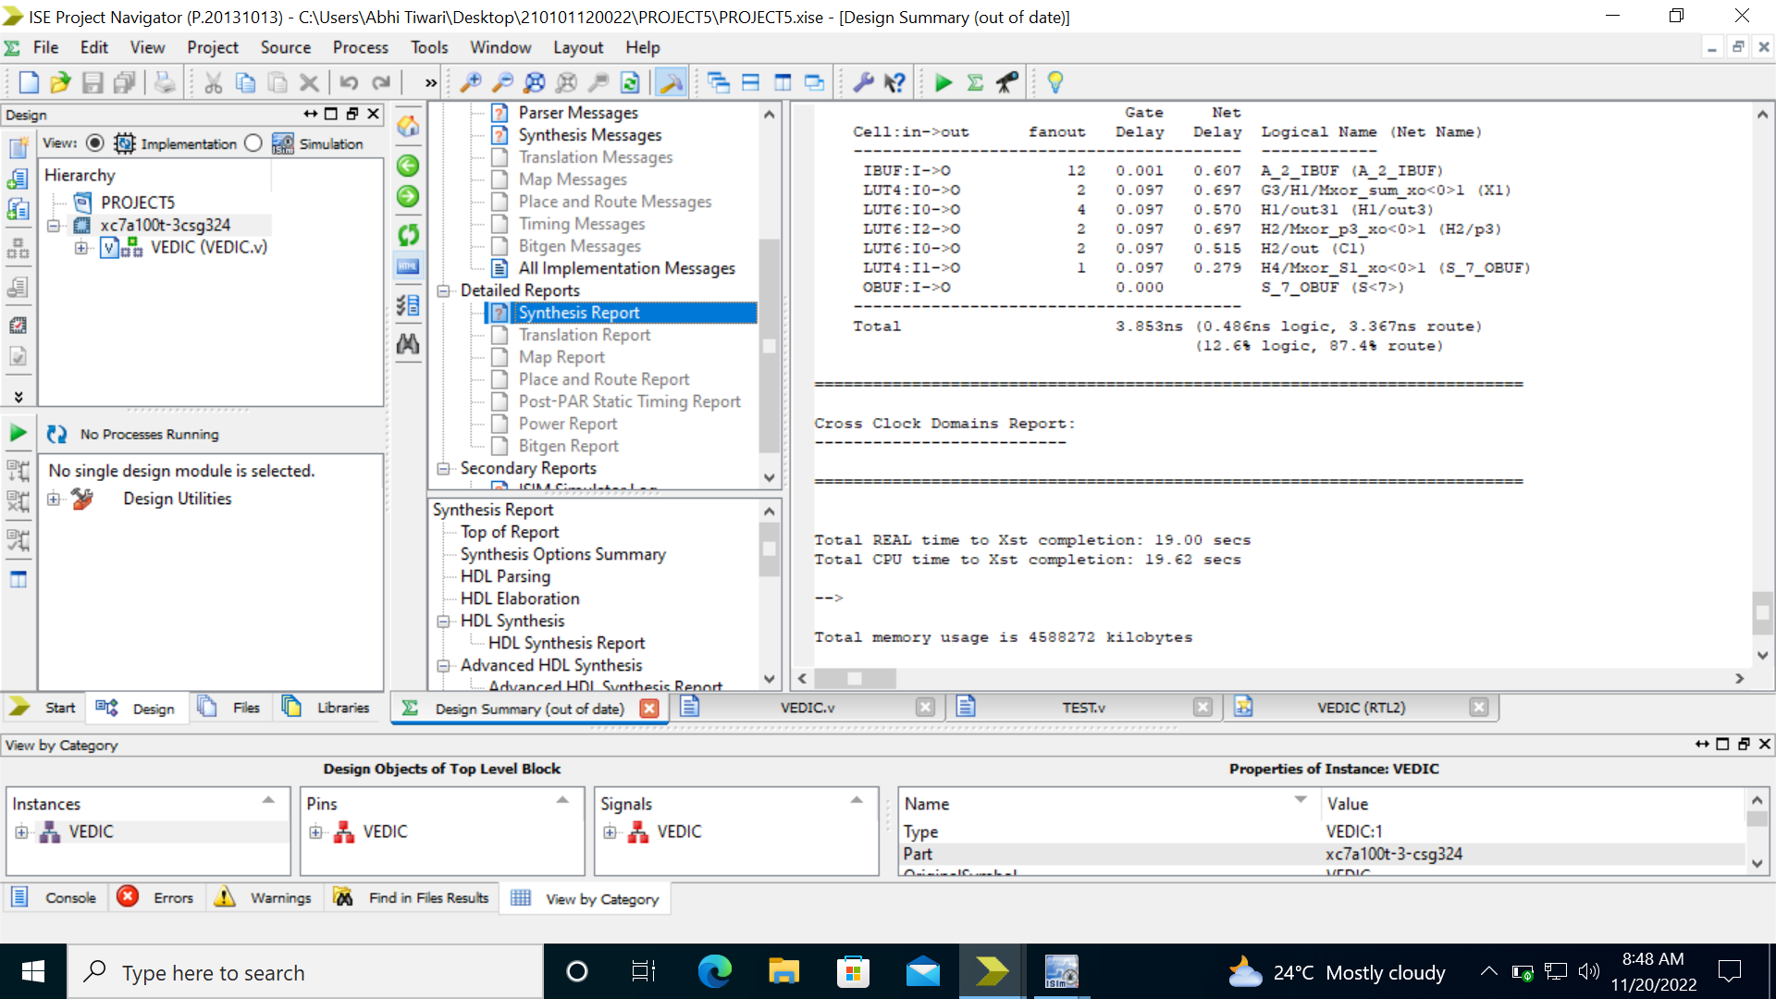
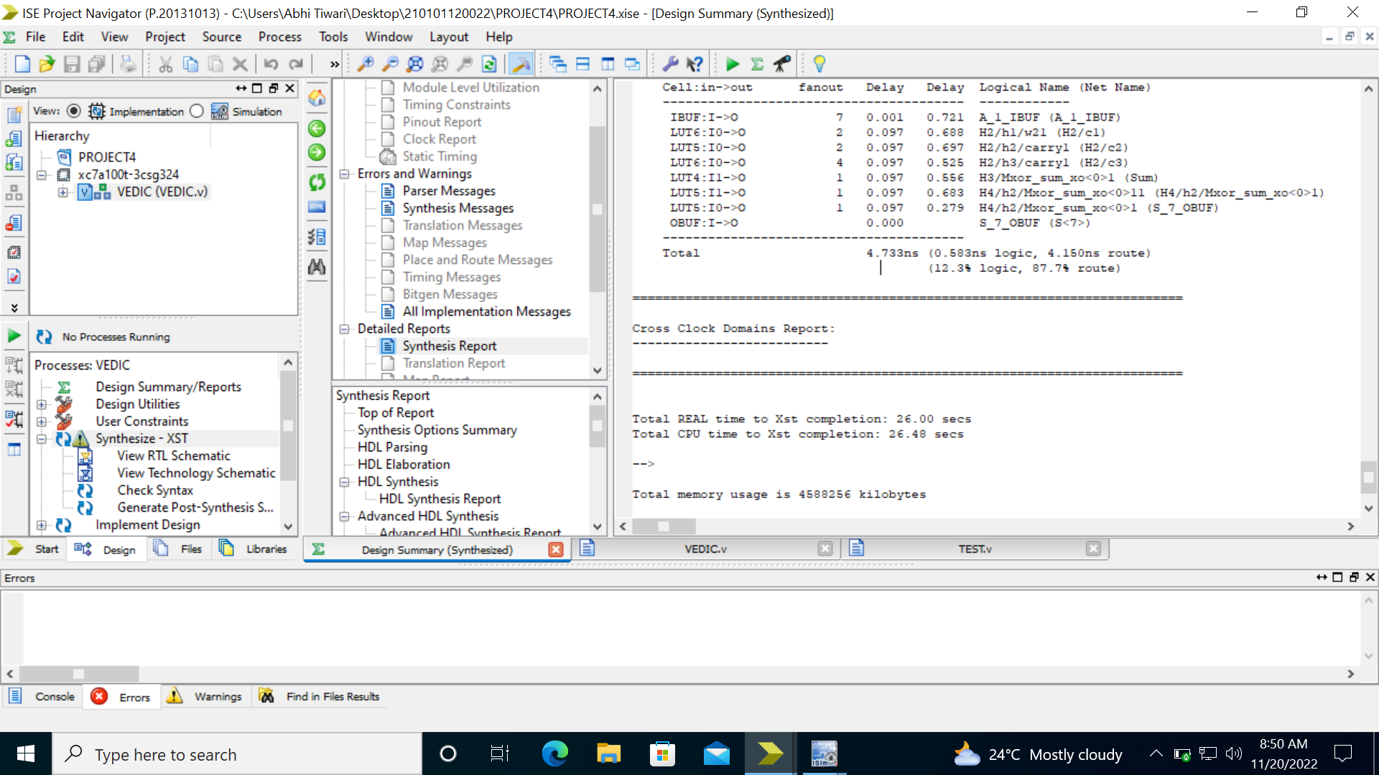
Design Summary and Total Combinational Delay Using Carry Look Ahead Adder
Design Summary and Total Combinational Delay Using Parallel Adder

Slide 24
Conclusion
It can be concluded that Vedic Multiplier is superior in all respect like speed, delay, complexity. Ancient Indian Vedic Mathematics gives efficient algorithms or formula for multiplication which increase the speed of devices

Slide 25
Reference
VLSI Class notes
https://www.semanticscholar.org/paper/Design-of-Vedic-multiplier-using-Urdhva-Tiryagbhyam-Sutra/29e50274fddab42ec935af57a39aac92080c9e6c
https://www.ijariit.com/manuscripts/v5i3/V5I3-1340.pdf
https://ijarsct.co.in/Paper1912.pdf

Slide 26
Thank You...…

